Slide 1
Introduction to
transitions materials
Dr Simon Tate

Slide 2
Academic Transition

Slide 3
Academic Transition
Bryson, J.R. (1997) Breaking through the A level effect: a first-year tutorial in student self-reflection Journal of Geography in Higher Education, 212, pp. 163-169.
Castree, N., Fuller, D. & Lambert, D. (2007) Geography without borders, Transactions of the Institute of British Geographers, 32, pp. 129-32.
Maguire, S., Evans, S.E. & Dyas, L. (2001) Approaches to learning: a study of first year geography undergraduates Journal of Geography in Higher Education, 251, pp. 95-107.
Marriott, A. (2007) The transition from A level to degree geography Teaching Geography, 321, pp. 49-50.
Prykett, J. & Smith, M. (2009) Rediscovering school geographies: connecting the distant worlds of school and academic geography Teaching Geography, 341, pp. 35-38.
Stannard, K. (2003) Earth to academia: on the need to reconnect university and school geography Area, 35, pp. 316-32.

Slide 4
Academic Transition
‘University and pre-university geography [in the UK] are like distant relations: there is a family connection but it is fairly weak’
(Castree, Fuller & Lambert, 2007, p.130).

Slide 5
Academic Transition
Huckle (2002) juxtaposes postmodern academic geography with stubbornly modern school geography
Prykett and Smith (2009, p.35) express the concern of many teachers and senior examiners ‘have not been able to keep up-to-date with current developments in an ever evolving discipline’.

Slide 6
Headline
While the existing literature focuses heavily upon the disjuncture in subject knowledge faced by those making the transition from A-level to university-level geography, students perceived their lack of skills to be the most significant obstacle to their learning and progression.
Disappointment through to anger and fear at how inadequately prepared for university they considered themselves to be.
Some placed the blame squarely on the exam boards:
“Students on the [exam board name removed] course are left with no idea of the university curricula ahead.” (Student B39).

Slide 7
Academic Transition
“Students are left unprepared for the massive change in approach to the study of geography at university.” (Lauren)
“There needs to be a fundamental change in A-levels to move from a spoon-fed learning experience.” (Amy)
“Sixth form students go from using a small selection of very large board topic text books to using massive amount[s] of literature spanning journals, books and research papers. Trying to get used to this way of working made starting here a bloody nightmare at first.” (Andrew)
“Looking back my A-level course didn’t enable students to think for themselves and consider other possible explanations…it could be said facts were taken at face value.” (Rob)

Slide 8
Findings: Academic Transition
“Students are left unprepared for the massive change in approach to the study of geography at university.” (Lauren)
“There needs to be a fundamental change in A-levels to move from a spoon-fed learning experience.” (Amy)
“Sixth form students go from using a small selection of very large board topic text books to using massive amount[s] of literature spanning journals, books and research papers. Trying to get used to this way of working made starting here a bloody nightmare at first.” (Andrew)
“Looking back my A-level course didn’t enable students to think for themselves and consider other possible explanations…it could be said facts were taken at face value.” (Rob)

Slide 9
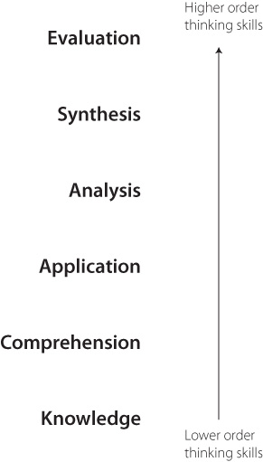
Figure 1: Bloom's Taxonomy of the Cognitive Domain (Bloom et al, 1956).

Slide 10
Social Transition Challenges
Christie, H & Grant, F (2004) The experiences of first year students: encouraging student retention, Research Briefing No.3, August 2004.
Christie, H Munro, M & Rettig, H (2001) Making ends meet: student incomes and debt, Studies and Higher Education, 26 (3), pp. 363-383.
Maguire, S Evans, SE & Dyas, L (2001) Approaches to learning: a study of first-year geography undergraduates, Journal of Geography in Higher Education, 251, pp. 95-107
Patiniotis, J & Holdsworth, C (2005) ‘Seize that chance!’ Leaving home and transitions to higher education, Journal of Youth Studies, 8 (1), pp. 81-95.
Read, B Archer, L & Leathwood, C (2003) Challenging cultures? Student conceptions of “belonging” and “isolation” at a post-1992 university, Studies in Higher Education, 28, pp. 261-277.
Scanlon, L Rowling, L & Weber, Z (2007) ‘You don’t have like an identity… you are just lost in a crowd’: forming student Identity in the first-year transition to university, Journal of Youth Studies, 10 (2), pp. 223-241.
Wilcox, P Winn, S & Fyvie-Gauld, M (2005) 'It was nothing to do with the university, it was just the people': the role of social support in the first year experience of higher education, Studies in Higher Education, 30 (6), pp. 707-722.

Slide 11
Social Transition Challenges
Initial strong feelings of isolation
Local, non-local, mature, part-time, foreign,
Sense that many students felt very marginalised for the first few weeks of university.
Access to HoR and student night life key to settling in.
First 2 weeks key to retention

Slide 12
Social Transition Challenges
Travel time and a fragmented timetable
‘I know it sounds ridiculous but sometimes when there is only one lecture timetabled for a day, and you are going to be on the bus for over an hour to get to uni, I sometimes think is it worth it?’ (Jack)
‘I only come into Uni on days when there is a class on and do my reading and essay writing at home. Trouble is that doesn’t help you get to know other people.’ (Kevin)

Slide 13
Some Solutions……

Slide 14
Some Solutions……

Slide 15
Some Solutions……
Early interventions - pre-induction, mentoring and
extended inductions
Social networking
Bespoke session in induction programme for WP students
Early fieldtrips to help students to get to know each other
Timetable flexibility (e.gs seminar groups, tutor groups)
Participatory teaching can aid transition

Slide 16
To conclude
Academic transition materials:
Attempt to shape the future nature of the academic transition from post-16 to university geography
Begin to address the social transition to university

Slide 17
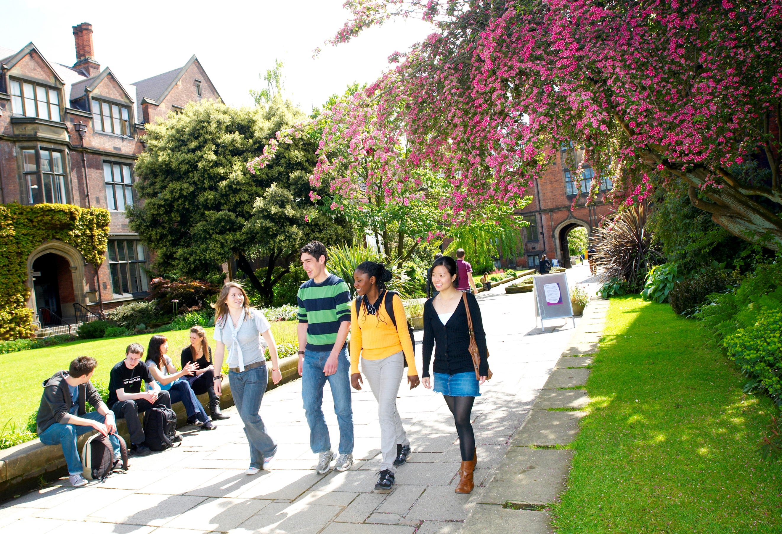
Thanks for listening
http://research.ncl.ac.uk/studenttransitions

